Slide 1
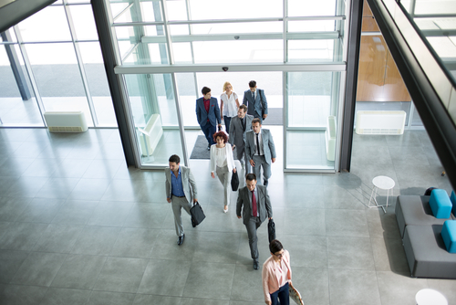
Visitor flow surveilance
A project about Movement monitoring

Slide 2

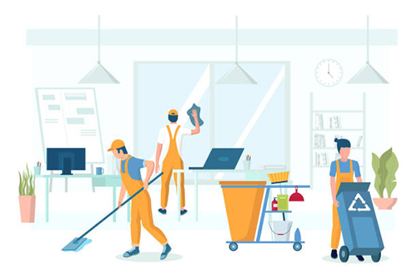
Why collect this data?
Staff planning
investment validation
Cleaning services
Resource planning
Notes:
Staffplanning: How much staff is needed on this youth recreation center?
Investment validation: Do people actually use this facility, when in the day is it used?
Cleaning service: and garbage handling
Resource planning: On this specific week day usually many people go to this place and then we need this many police in the area.

Slide 3
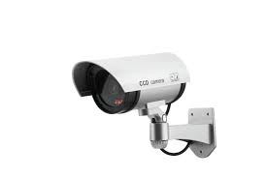
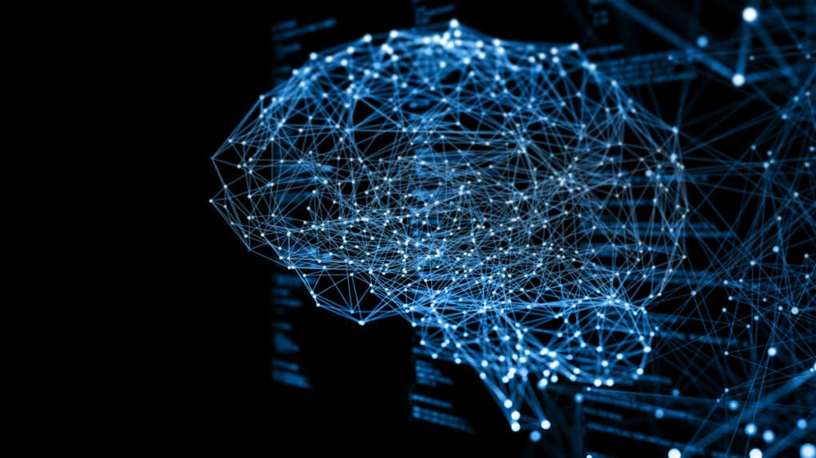
Modern applications
Camera stream connected to computer
Ai scans video and counts
Cons:
Cameras are not allowed everywhere
Feeling of always beeing watched
Requires powerful and expensive hardware
Notes:
Camera connected to computer: both over network or direct
Camera are not allowed in some areas, requires application for permissions

Slide 4
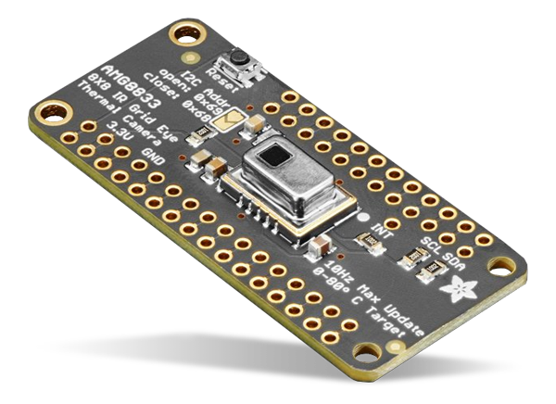
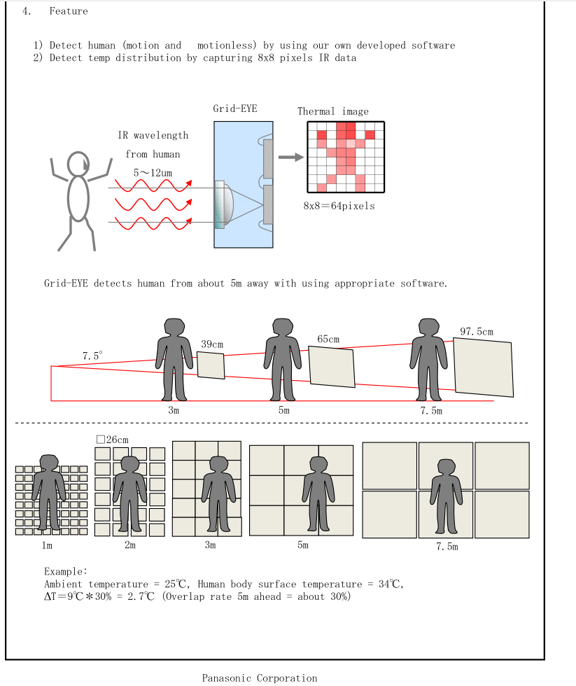
AMG8833 IR Thermal Camera
Returns Array with 64 temperatures
”Can detect a human from a distance of up to 7 meters”

Slide 5
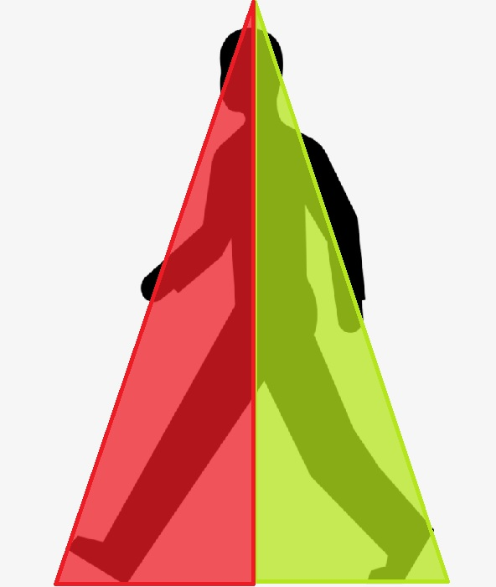
Sence movement
Divided the 64 pixels into two zones
Looks at difference in average temperature
Notes:
Looks at diffrence in average temperature between zones and can by that tell in what direction someone is passing the sensor.

Slide 6
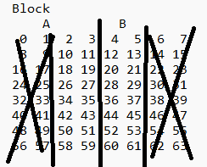

Optimization
By using fewer pixels the zones gets less noice
Notes:
From sensors perspective
Right now i am only using the 32 middle pixels because that turned out to give less background noice.

Slide 7
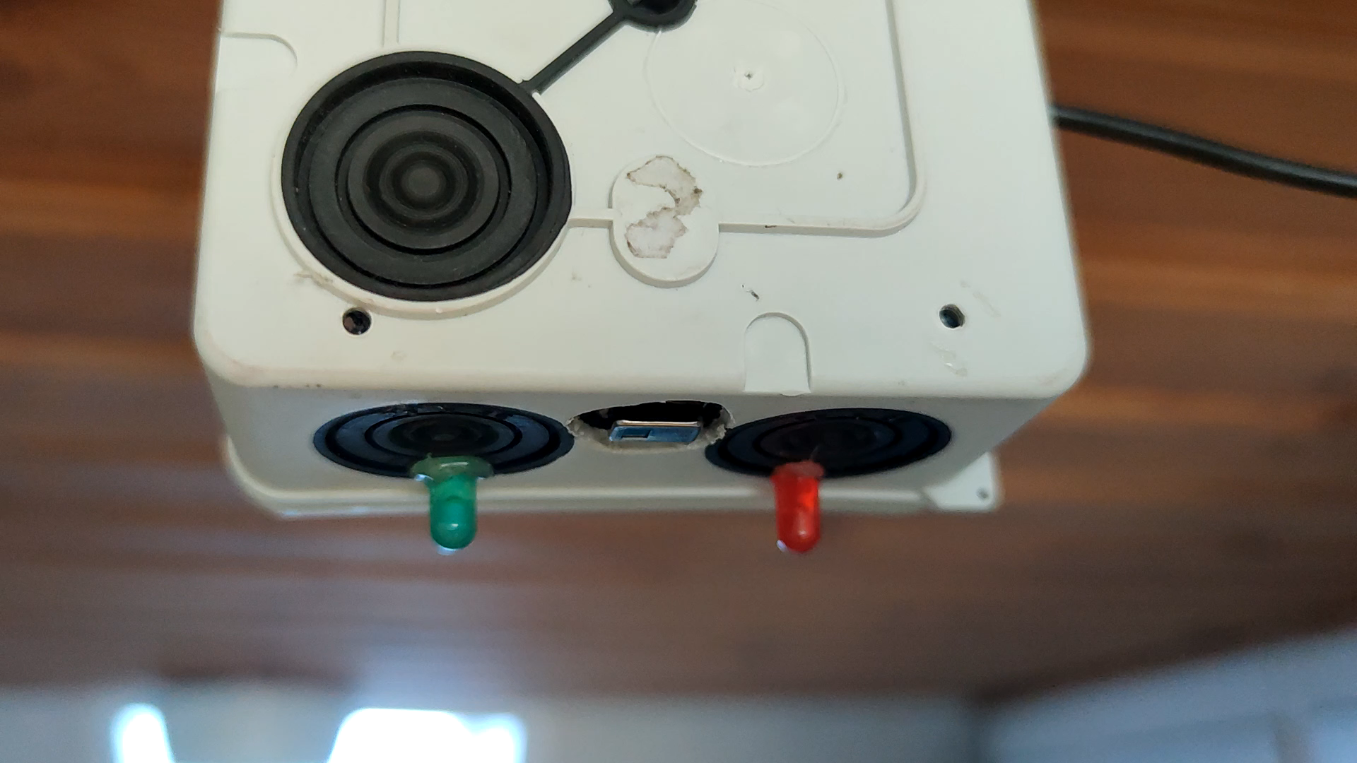
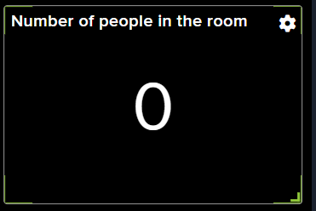
Optimization
Fine tuning Temperature difference limit
Depends on mounting location
Too low: below 0.4 °C
Too high:
Above 1 °C
Notes:
A lower gives easier sensing but are more prone to noise
A too high value will cause the device too miss humans passing.
The perfect value for the two locations i have tried seem to be somewhere between 0.5-0.9 deggrees.
Before optimization was done it triggered easily. Vacuum robot triggered it and on the cloud service it said that it was 42 pople in my small kitchen.

Slide 8
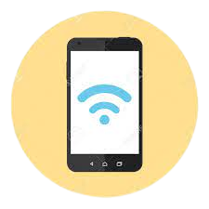
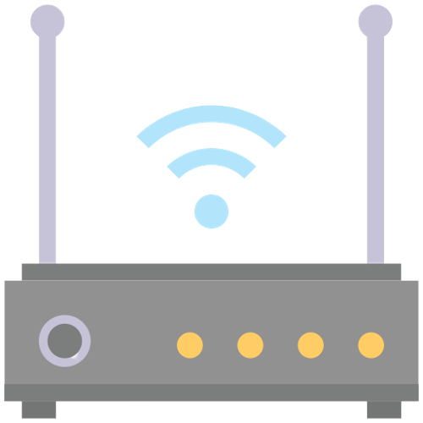
WiFi traffic scanning
Smartphones with wifi turned on
Scans for wifi nodes
estimates how many people are nearby
Notes:
Looks at individual devices by looking at their mac adress.

Slide 9


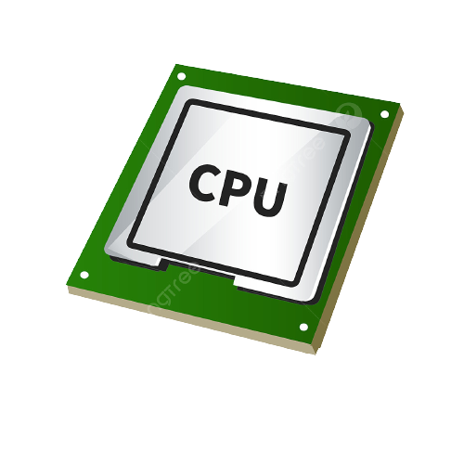
Promiscuous mode
Non-promiscuous mode (normal)
2
1
2
1
2
2
1
1
MAC address: 1
MAC address: 1
Notes:
Need a device that supports promiscuis mode
CPU can look at packet information and retrive the mac address of the package

Slide 10
TTL- Time To Live
Inititiation scan adds background traffic to ignore list
New unknown devices gets a ttl of 60 seconds
The timer is reset every time the mac-address is found
If the ttl gets below zero, the address is dropped

Slide 11
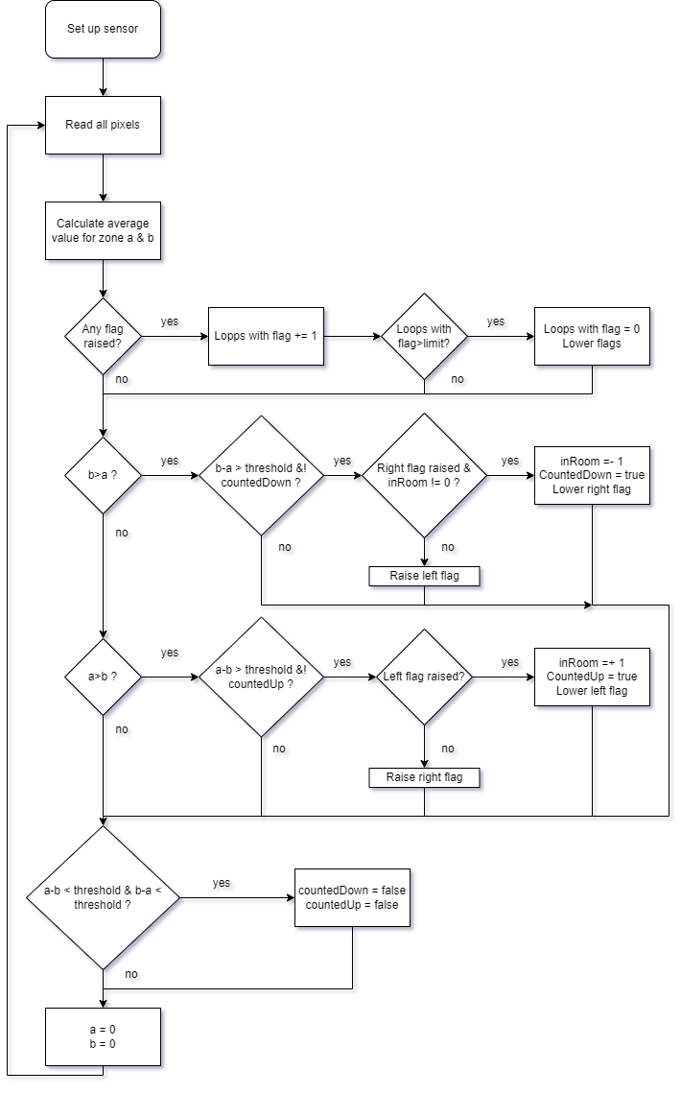
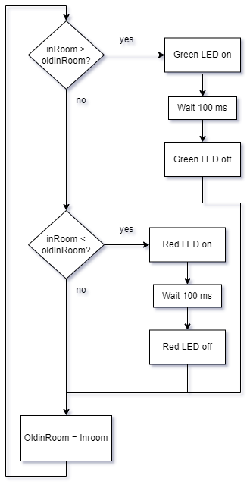
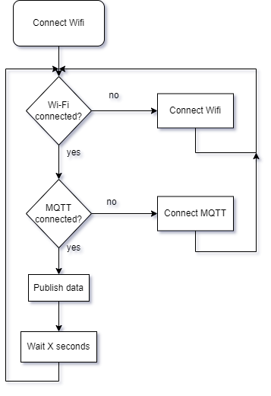
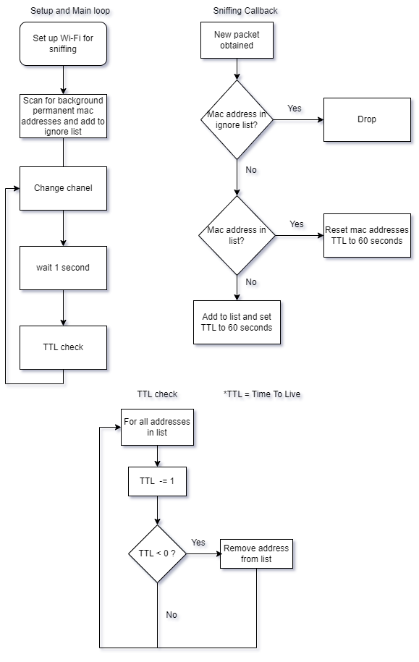
The tasks
Priority: High
Core: --
Priority: Low
Core: 0
Movement monitoring
LED indication
Wifi packet sniffer
Wifi client & mqtt
Priority: Medium
Core: 0
Priority: Medium
Core: 0
Notes:
Code is structured into four tasks
FreeRTOSlets you set core and priority
Describe different tasks

Slide 12
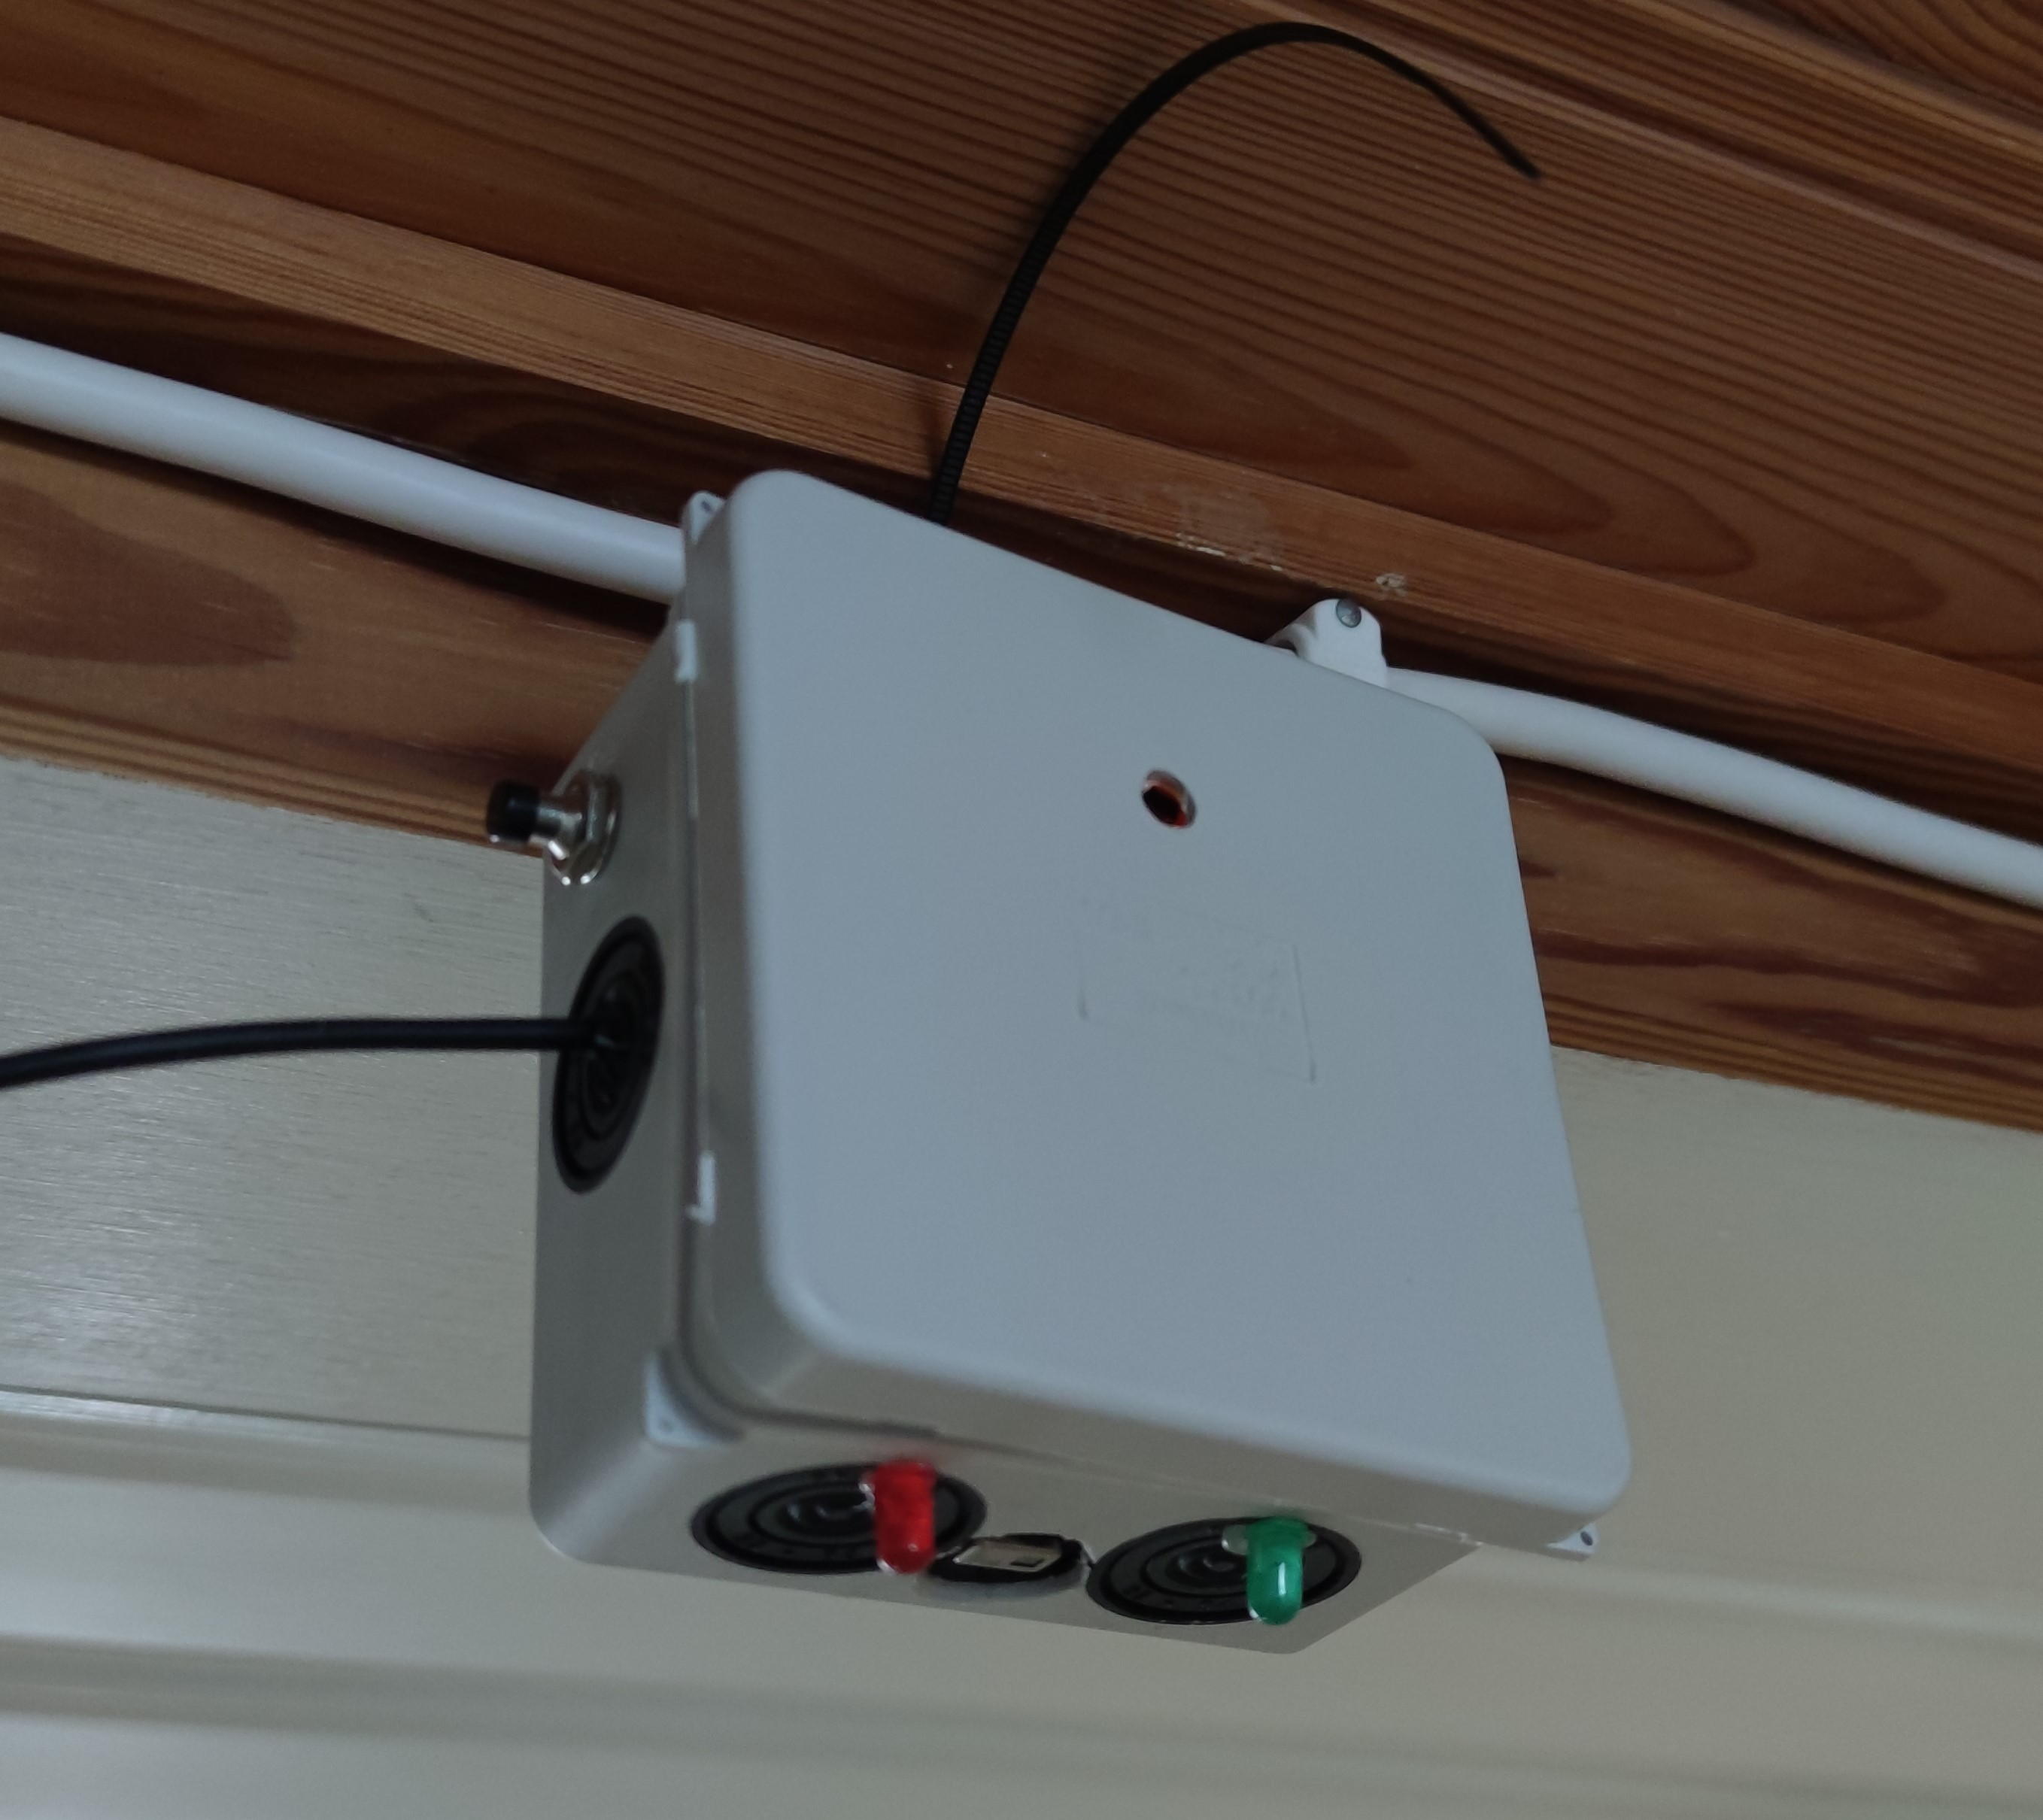
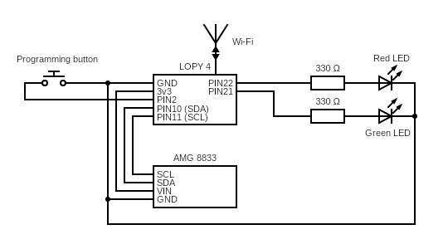
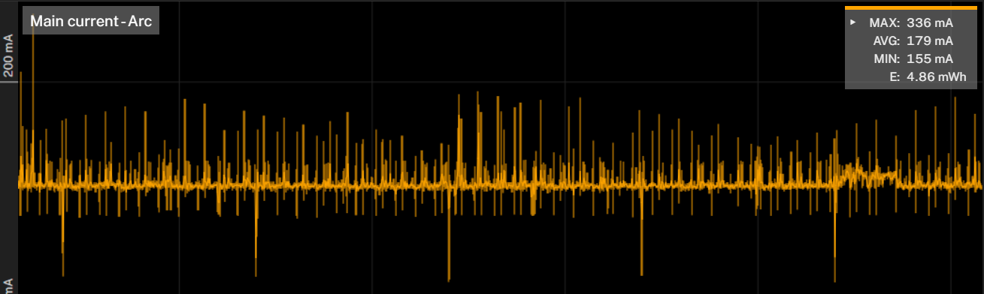
The device
Fitted into connection box
Had to add a button
Higher power consumption than expected
Notes:
Battery is no option

Slide 13
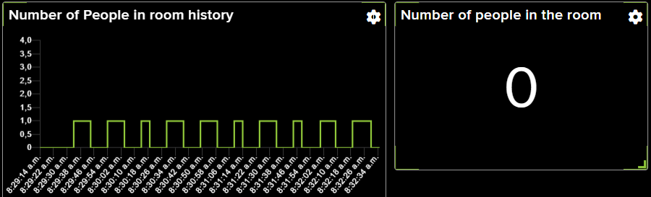
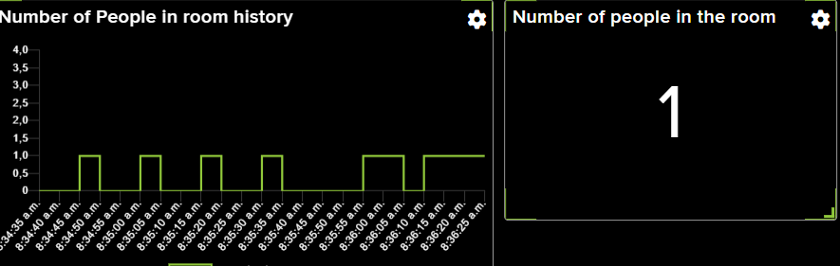
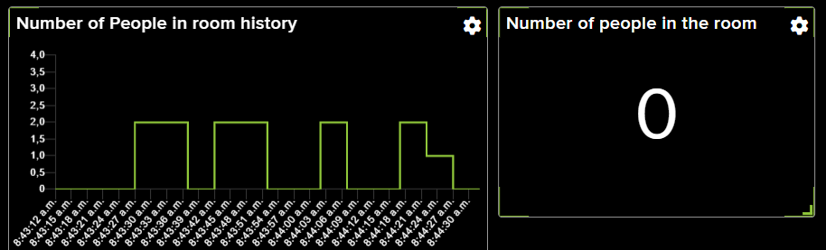
Positive results
Walking in and out ten times
Running in and out five times
Walking in and out with boiler in hand four times
Notes:
Looks at individual devices by looking at their mac adress.

Slide 14
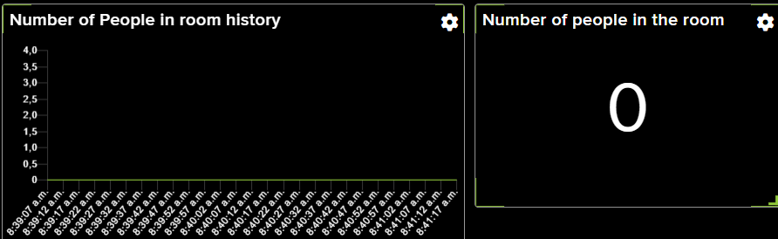
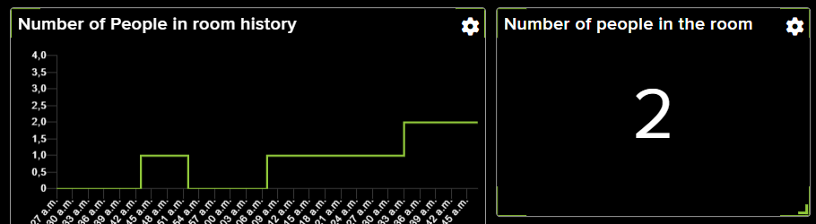
Negative results
Walking in and out five times with hat and jacket
Walking but stopping under sensor for ten seconds then continue (five times)
Notes:
Issue with vauum robot

Slide 15
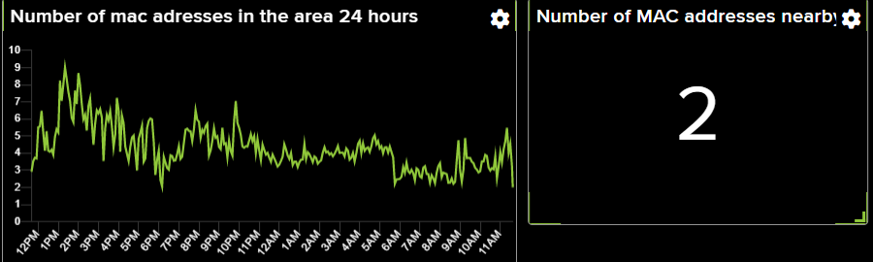
Wi-Fi result
Reception is too strong
Improvement: add rssi controll
Notes:
Pics up packets from people walking and driving by house.
All neighbours devices.

